Slide 1
Quiz loops
Simeon Angelov
Notes:
Hello everyone in the course on:
With me:

Slide 2
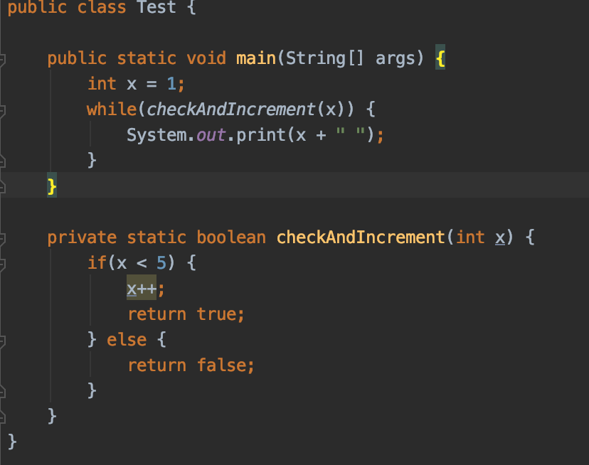
Q1. What is the result of compiling and executing the code ?
a) 1 2 3 4
b) Infinite loop
c) 1 2 3 4 5
d) 2 3 4 5

Slide 3
Q2. Which of the following statement is correct about below code?
public class Test {
public static void main(String[] args) {
do {
System.out.println(100);
} while (false);
System.out.println("Bye");
}
}
100 Bye
Compiles successfully and prints 100 infinitive
Compiles successfully and prints Bye
Unreachable code compilation error

Slide 4
Q3. What is the result of compiling and executing of Test class ?
​
a) Produces no output
​ b)
5 6 7 8 9
​
c) It will go in an infinite loop
public class Test {
public static void main(String[] args) {
int x = 5;
while (x < 10)
System.out.println(x);
x++;
}
}

Slide 5
Q4 How many times will be printed “Welcome to java” ?
0
9
10
int count = 0; while (count < 10) { System.out.println("Welcome to Java"); count++; }

Slide 6
Q5 What will be the value of the variable tester value when this loop is finished?
int tester_value = 0;
for (int i=0; i<=5; i++) { tester_value+=i; }
a) 10
b) 3
c) 15
d) 1

Slide 7
Q6 Which is correct syntax ?
a)
for(<10) {}
b)
for(i++) {}
c)
for(int i=0; i<10;i++) {}
d) for(i=0;i++) {}

Slide 8
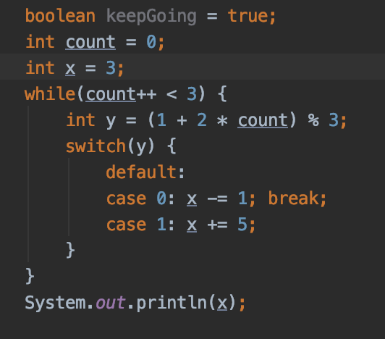
Q7. What is the output of the following program?
4
5
6
7
13
Compilation error at line 5
Notes:
count = 1;
Y = 0;
X = 3 – 1 = 2;
count = 2; y = (1 + (2 * 2)) % 3 = 5 % 3 = 2;
X = 2 - 1 = 1;
Count = 3; y = (1 + (2 * 3) % 3; = (1 + 6) % 3 = 1;
X = 1 + 5 = 6;

Slide 9
Q8. What data type (or types) will allow the following code snippet to compile? (Choose all that apply)
int
long
boolean
double
short
byte
byte x = 5; byte y = 10;
_____ z = x + y;

Slide 10
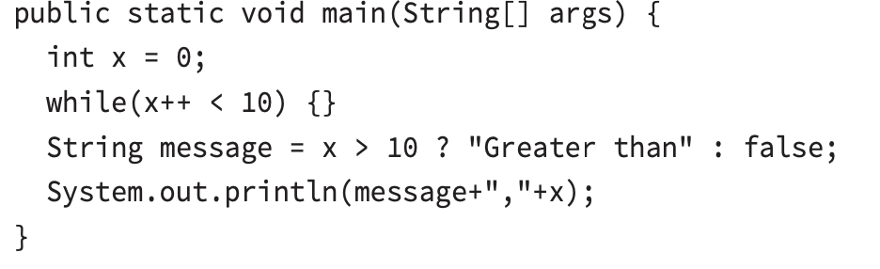
Q9. What is the result of compiling and executing the next code snipt?
Greater, than 10
false, 10
Greater, than 11
false, 11
Compilation error at line 4
Compilation error at line 5
Notes:
e) Because we trying to sign a Boolean to a String

Slide 11
Q10. What change would allow the following code snippet to compile?
a) No change required
b) Cast x on line 4 to int.
c) Change the data type of x on line 1 to short.
d) Cast 2 * x on second line to int.
f) Change the data type of y on line 2 to short.
e) Change the data type of y on line 3 to long.
long x = 10;
int y = (2 * x);

Slide 12
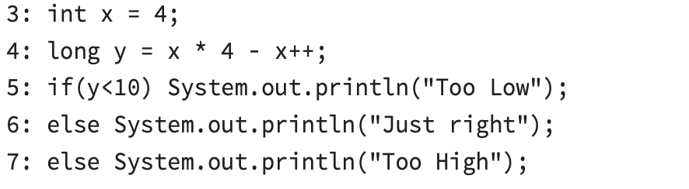
Q11. What is the result of compiling and executing this code ?
Too Low
Just right
Too high
Compiles but throws NullPointerException
The code will not compile because of line 6
The code will not compile because of line 7

Slide 13
Q. 12 Which is the result of compiling and executing of the code ?
5
4
8
7
Compilation Error at line 2
int x = 5; System.out.println(x > 2 ? x < 4 ? 10 : 8 : 7);

Slide 14
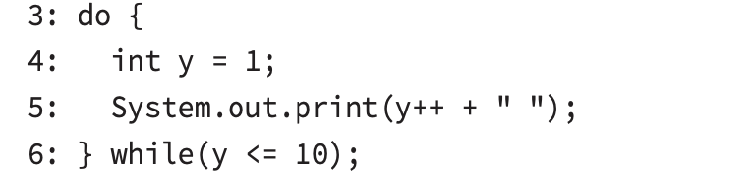
Q. 13 What is the output of the code ?
a) 1 2 3 4 5 6 7 8 9
b) 1 2 3 4 5 6 7 8 9 10
c) 1 2 3 4 5 6 7 8 9 10 11
d) The code will not compile because of line 6.
e) The code contains an infinite loop and does not terminate.

Slide 15
Thank You For Your Time

